Slide 1
Build and Release Management
Continues Integration and continues Delivery/Deployment
<Madhu>
<Assistant Manager>
<September, 2019>

Slide 2
Required Tools
Git/GitHub: For version controlling
Maven: Build automation is the act of scripting or automating a wide variety of tasks
Nexus/S3: Artifact storage purpose
Jenkins: CI/CD Purpose, Automate the Scripted Pipeline & Declarative Pipeline Process and as well as Master Slave/Node Mechanism.
Docker: Containerization of the Servers.
© Integra.

Slide 3
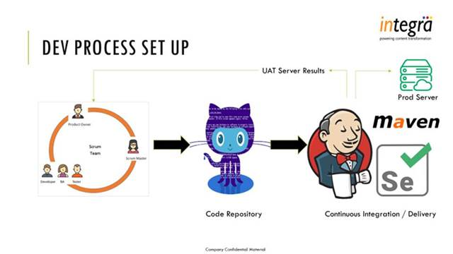
© Integra.

Slide 4


Software Configuration Management:
SCM is a process of tracking and controlling changes in the software
The goals of SCM are generally
  Teamwork
  Defect tracking
  Configuration auditing
  Process management
  Distributed repository approach – every checkout of the repository is a full fledged repository, complete with history
  Greater redundancy and speed
  Branching and merging repositories is more heavily used as a result
© Integra.

Slide 5
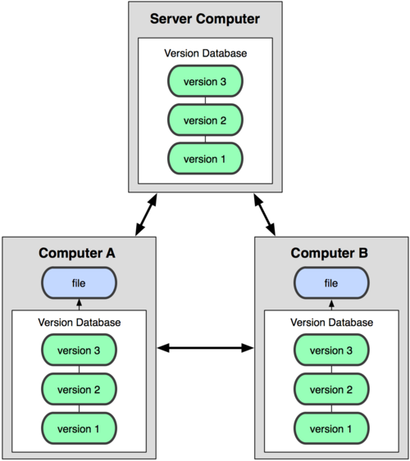
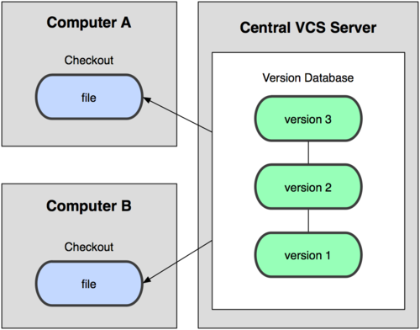
Distributed version control system
Centralized Model
Distributed Model
(CVS, Subversion, Perforce)
© Integra.

Slide 6
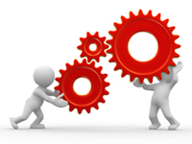

“Maven is a project management tool which encompasses a project object model, a set of standards, a project lifecycle, a dependency management system, and
logic for executing plugin goals at defined phases in a lifecycle”
Maven provides superset of features found in a build tool
Maven manages project build, reporting, and documentation from a central piece of information
© Integra.

Slide 7
Build management
It is the process of compiling and assembling a software system
Build automation is the act of scripting or automating a wide variety of tasks
  Compiling source code
  Packing binaries
  Running automated tests
  Deploying to production system
  Creating documentation
© Integra.

Slide 8
Characteristics of MAVEN
Maven is more than just Build Tool
Maven was built considering certain objectives
Maven Provides:
Easy Build Process
Uniform Build System
Quality Project Information
Guidelines for Best Practices Development
Achieved Characteristics:
Visibility
Reusability
Maintainability
Comprehensibility “Accumulator of Knowledge”
© Integra.

Slide 9
Maven Build Lifecycle
A Maven build follow a lifecycle
Default lifecycle
  generate-sources/generate-resources
  compile
  test
  package
  Install
  deploy
There is also a Clean, Site lifecycle
© Integra.

Slide 10
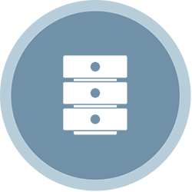
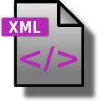
Overview of Simple Architecture
Build System
(goals)
http
pom.xml
maven
Local
Repo
Remote
Repo
© Integra.

Slide 11
Nexus/S3 Bucket
Jenkins: Publish Maven Artifacts to Nexus OSS Using Pipelines or Maven JobsJenkins:
Also store the release version of packages in the Nexus repository .
© Integra.

Slide 12
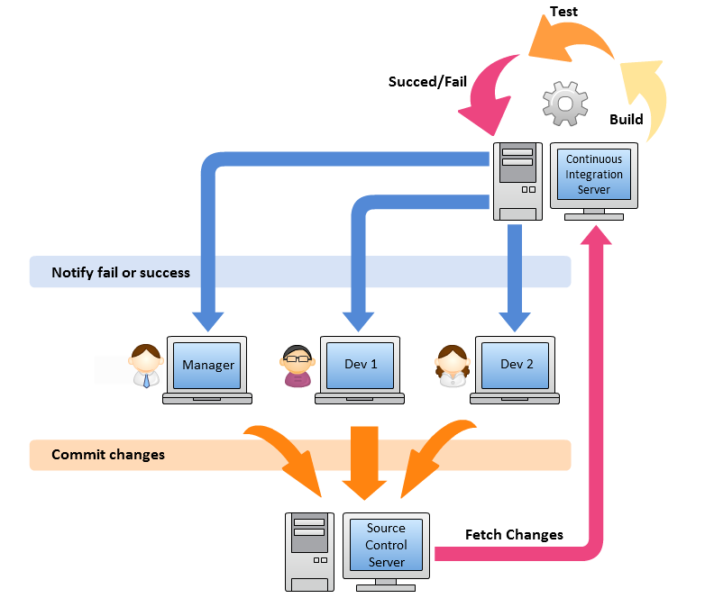
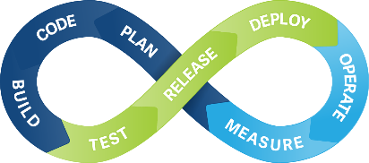
Jenkins: CI/CD Process
© Integra.

Slide 13







Continuous Integration
Build
UnitTest
Stage
Continuous Delivery
Build
UnitTest
Stage
Acceptance
Test
Deploy
Continuous Deployment
Build
UnitTest
Stage
Acceptance
Test
Deploy
© Integra.
© Integra.

Slide 14
Over view of Jenkins
The application development life cycle is a traditionally lengthy and a manual process. In addition, it requires effective collaboration between development and operations teams. The deployment pipeline is a demonstration of automation involved in the application development life cycle containing the automated build execution and test execution, notification to the stakeholder, and deployment in different runtime environments. Effectively, the deployment pipeline is a combination of CI and continuous delivery, and hence is a part of DevOps practices.
© Integra.

Slide 15

Jenkins
  Build software so that it can be rapidly & safely deployed to production by delivering every change to a production-like environment
  Ensuring business applications and services function as expected through rigorous automated testing
  Manual trigger of deployment when business is ready
  Every change is proven to be deployable at any time using CI/CD Process
  Continuous Delivery = Continuous Integration +
  fully automated test suite
© Integra.

Slide 16
Jenkins Best Practices
Always secure Jenkins
In larger systems, don't build on the master
Backup Jenkins Home regularly
Integrate tightly with your issue tracking system, like JIRA to reduce the need for maintaining a Change Log
Set up Jenkins on the partition that has the most free disk-space
Archive unused jobs before removing them
Avoid scheduling all jobs to start at the same time
© Integra.

Slide 17
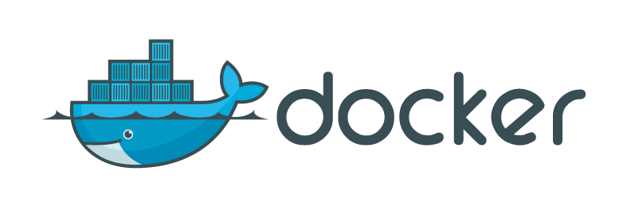
Docker is a platform for developing, shipping & running applications using an open-source container based technology
OS level virtualization
Run everywhere – physical or virtual or cloud
Run anything – if it can run on host, it can run in the container
Scalable - lightweight
Portable – Docker's Apps can run anywhere
Build any app in any language using any stack
You don't have to pre-allocate any RAM
Docker ensures your applications and resources are isolated and segregated
Environment Standardization and Version Control
© Integra.

Slide 18
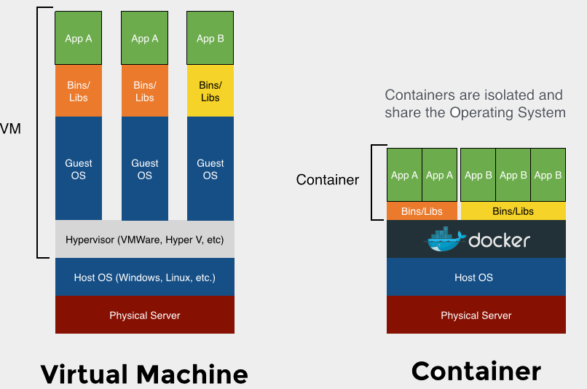
Virtualization vs Containers
© Integra.

Slide 19
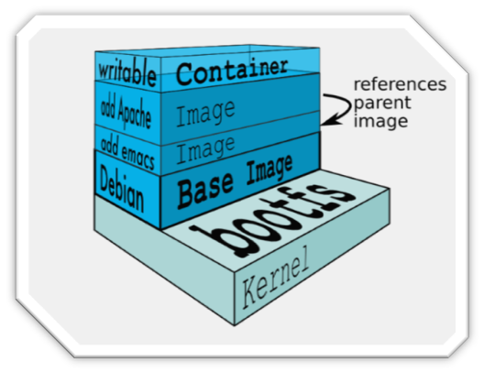
Docker images
Docker image is made up of file systems layered over each other
A Docker base image is nothing but an OS user space minus the kernel
Base is a boot filesystem, bootfs uses a Union File System & root filesystem stays in read-only mode
UnionFS allows files and directories of separate file systems, to be transparently overlaid, forming a single coherent file system.
Basically a tar file
When a container is launched from an image, Docker mounts a read-write filesystem on top of any layers below
© Integra.

Slide 20






Docker components
Core components :
Docker Daemon
  Docker engine, runs on the host machine
Docker Client
  CLI used to interact with the daemon
Workflow components :
Docker Image
  Templates which holds the environment & your applications
Docker Container
  Run-time instances created from images. Start, Stop, Run, Delete
Docker Registry
  Public & Private repositories used to store images
Dockerfile
  Automates image construction
© Integra.

Slide 21
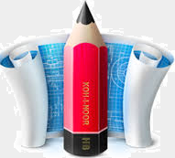
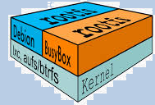

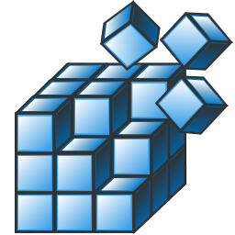
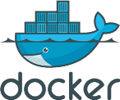
Docker system
Images
build
pull
push
commit
Dockerfile
start
stop
restart
Containers
Docker Registry
© Integra.

